Slide 1

American Sign Language Alphabet Image Classification
Team 5

Slide 2
The problem
4,600,000 million Americans report having disabling hearing loss
Only 500,000 Americans use ASL
2
1
Those with hearing disabilities have an extreme communication disadvantage
U.S. Department of Health and Human Services. (n.d.). Quick statistics about hearing. National Institute of Deafness and Other Communication Disorders. Retrieved May 5, 2022, from https://www.nidcd.nih.gov/health/statistics/quick-statistics-hearing
2. Mitchell, Ross; Young, Travas; Bachleda, Bellamie; Karchmer, Michael (2006). "How Many People Use ASL in the United States?: Why Estimates Need Updating" (PDF). Sign Language Studies. 6 (3). ISSN 0302-1475. Retrieved November 27, 2012.

Slide 3

The solution
Using Computer Vision
To Serve Those Hard of Hearing

Slide 4
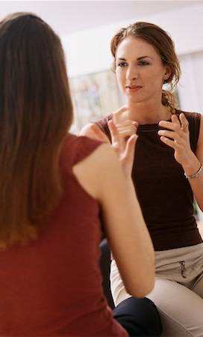
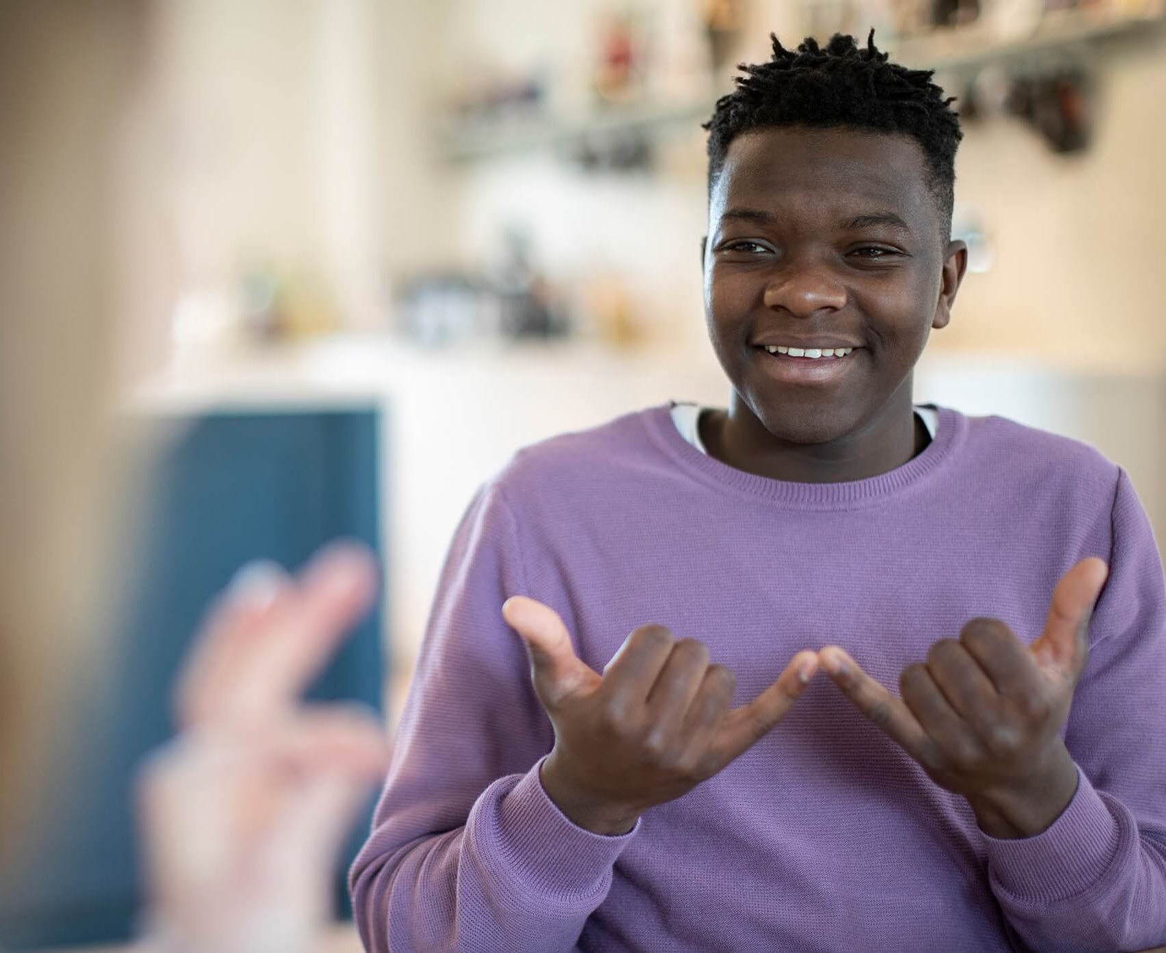

Goals
Further American Sign Language (ASL) Machine Learning research with the goal of assisting in eventual achievement of complete ASL real-time interpretation.
01 | Compile an accurate ASL alphabet data set
02 | Develop an ML model capable of learning ASL alphabet
03 | Pave the way for future expansion into ASL ML

Slide 5
Problems to solve
Data acquisition
Lack of uniform, well-labelled datasets at scale. Highly unstructured search results introduce prohibitive complications to a scraping pipeline
Color, Size, & Resolution Variance
Color, Size, & Resolution all introduce processing complications and can impact model performance if unoptimized
1
3
2
Signs that require motion
The letters J and Z require motion to execute. This presents an additional challenge for training a model as one class may have n numbers of acceptable still-frame positions throughout the motion.
4
File Size & Computing Requirements
The amount and size of image files required to train a well-performing model are likely to require distributed computing resources
Notes:
Zach

Slide 6
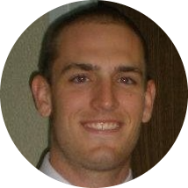


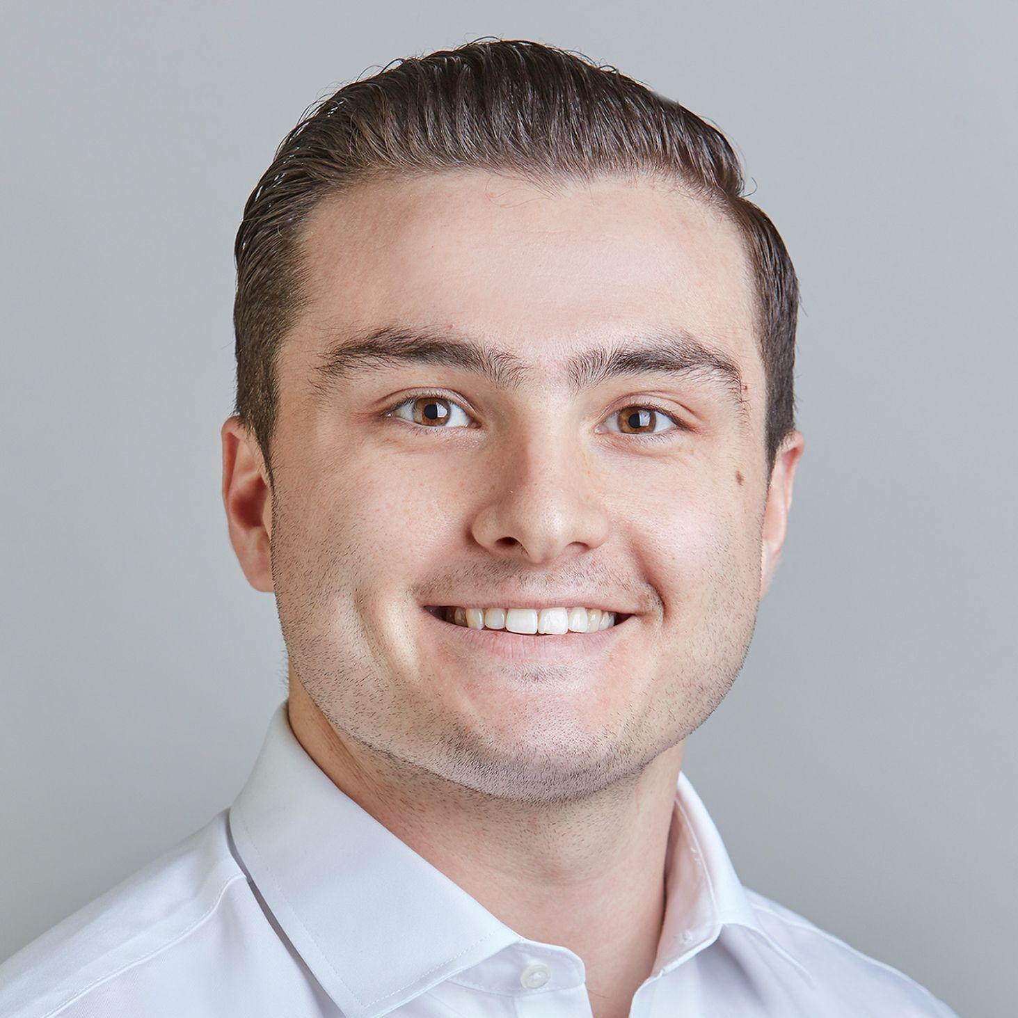
The team
Tyler Beard
Adam Bennion
Zach Carlson
Andrew Napolitano
Tyler has a career as a software engineer with over 10 years experience of work in the field. Strong coding skills will help in the data pre-processing, EDA, modeling and model deployment tasks. Having taken Deep Learning will help in focusing on the modeling portion of the project.
Adam is a software engineer with 4 years of professional experience and can contribute to all scripts required in the project. Adam will specialize in acquisition for the first portion of the project, then aid in classifier development in the second half. He also has Machine Learning and Deep Learning course experience.
Zach has a career as an analyst in both research and industry settings with 4 years of experience in project design, EDA, and data visualization. They’ll help with data acquisition, data pre-processing, model development, and repository documentation and management.
Andrew has a career in cyber security and data analytics consulting with a strong background in data visualization, modeling, team management, and communication. Andrew will be specializing in the data pre-processing/cleaning, EDA, modeling, and model deployment tasks of the project.
Notes:
everyone

Slide 7
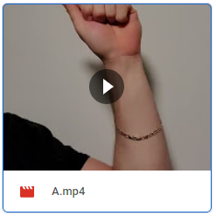
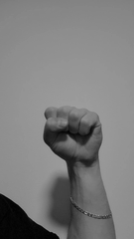
Acquisition & Preprocessing Pipeline
A journey from videos to vectors
Record video
Normalize resolution & size
Produce image vectors csv
Split videos to still frames
Apply grayscale
Recorded 30-second videos for each letter in the ASL alphabet
Reduced each image to 135x240 while maintaining original aspect ratio
Each image produced a 32,400 vector collected in a labelled csv file
Produced 900 images for each video
Reduce complexity in the image vectors
Notes:
Tyler

Slide 8

Preprocessing Examples
Notes:
zach

Slide 9

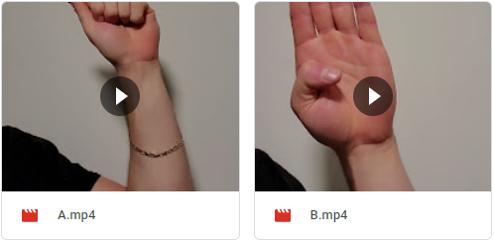
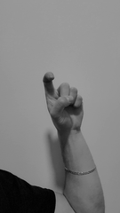
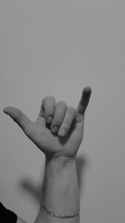
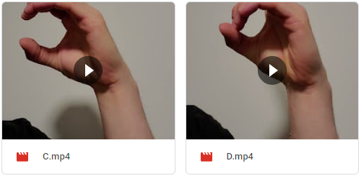
Preprocessing Examples
Notes:
zach

Slide 10
Potential obstacles
1
Dataset - insufficient quantity
Problem: With approximately 900 samples per class, the quantity is firmly within bounds of previous successful forays into ASL ML, however this data is as of yet untested.
Solution: Insufficiencies can be addressed by further acquisition using our proven pipeline.
2
Dataset - insufficient variety
Problem: Dataset may be too uniform.
Solution: This could be fixed with additional acquisition as mentioned above, or with image augmentation on existing samples. Augmentation could include random noise generation, contrasting, etc.
AB
Notes:
AB

Slide 11
Potential obstacles (cont.)
3
Training - high resource demand
Problem: With 2.55 GB in CSV format, the resource demand when training will likely be much more than a personal machine can handle.
Solution: Google Cloud Platform and Tux will likely be utilized. PCA with Johnson-Lindenstrauss Lemma if necessary.
AB
Notes:
AB

Slide 12
Appendix

